Slide 1
Gabriel Galeote Checa
Project Flexible, Biocompatible, and Wirelessly Powered Implantable Optoelectronics | What I did last four weeks? Design final version of the circuit. Design antenna Write abstract for conference paper Developed conceptual model of the device.
Problem being faced? ANTENNA | What to do in next two weeks? Find a solution for the antenna. Final etching of the device.

Slide 2
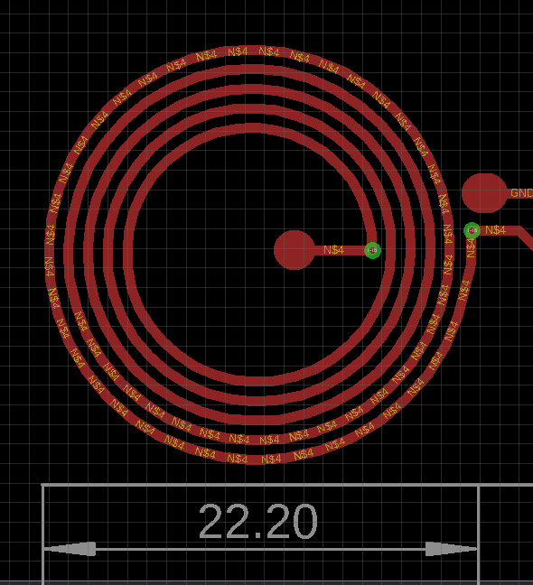
Bioimplantable Device
1. Current work
Antenna Designed
Parameters:
Number of turns = 5
wire width = 0.5 mm
Spacing = 0.5 mm
Outer Diameter = 22.2 mm
Inner Diameter = 12.3 mm

Slide 3
Bioimplantable Device
1. Current work
Planify tests for the final circuit:
Which tests to run?
What to measure?
Which environment to use?
Planify testing phase
Main points of the implant:
Modularity
Long shank (or variable shank)
Flexibility
Wireless Power Transmission (WPT)
Prepare conference Paper

Slide 4
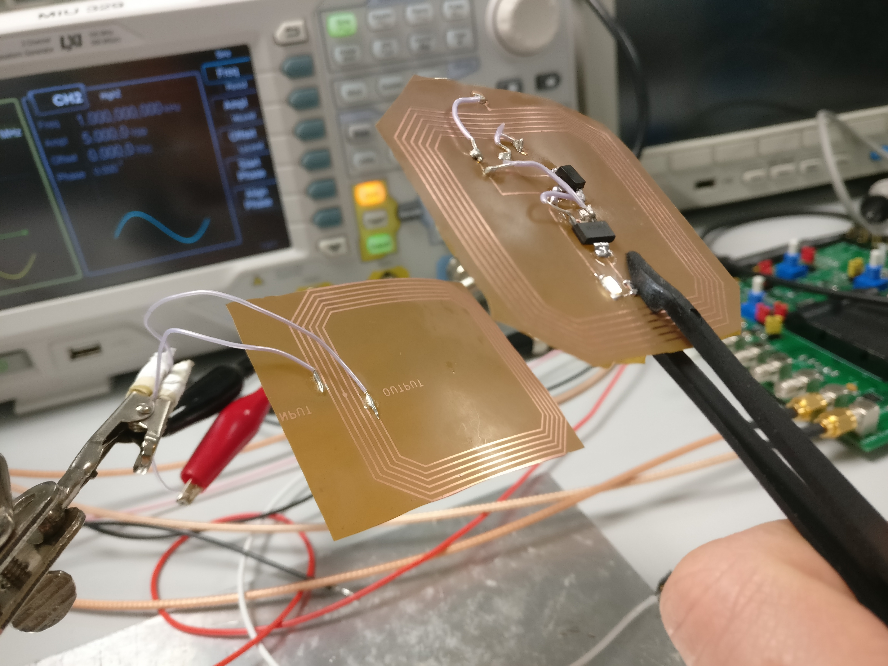
Bioimplantable Device
1. Current work
Resonant frequency → around 8 MHz
Using 10 Vpp (5V amplitude)
Tested in diferent angles and curvatures

Slide 5
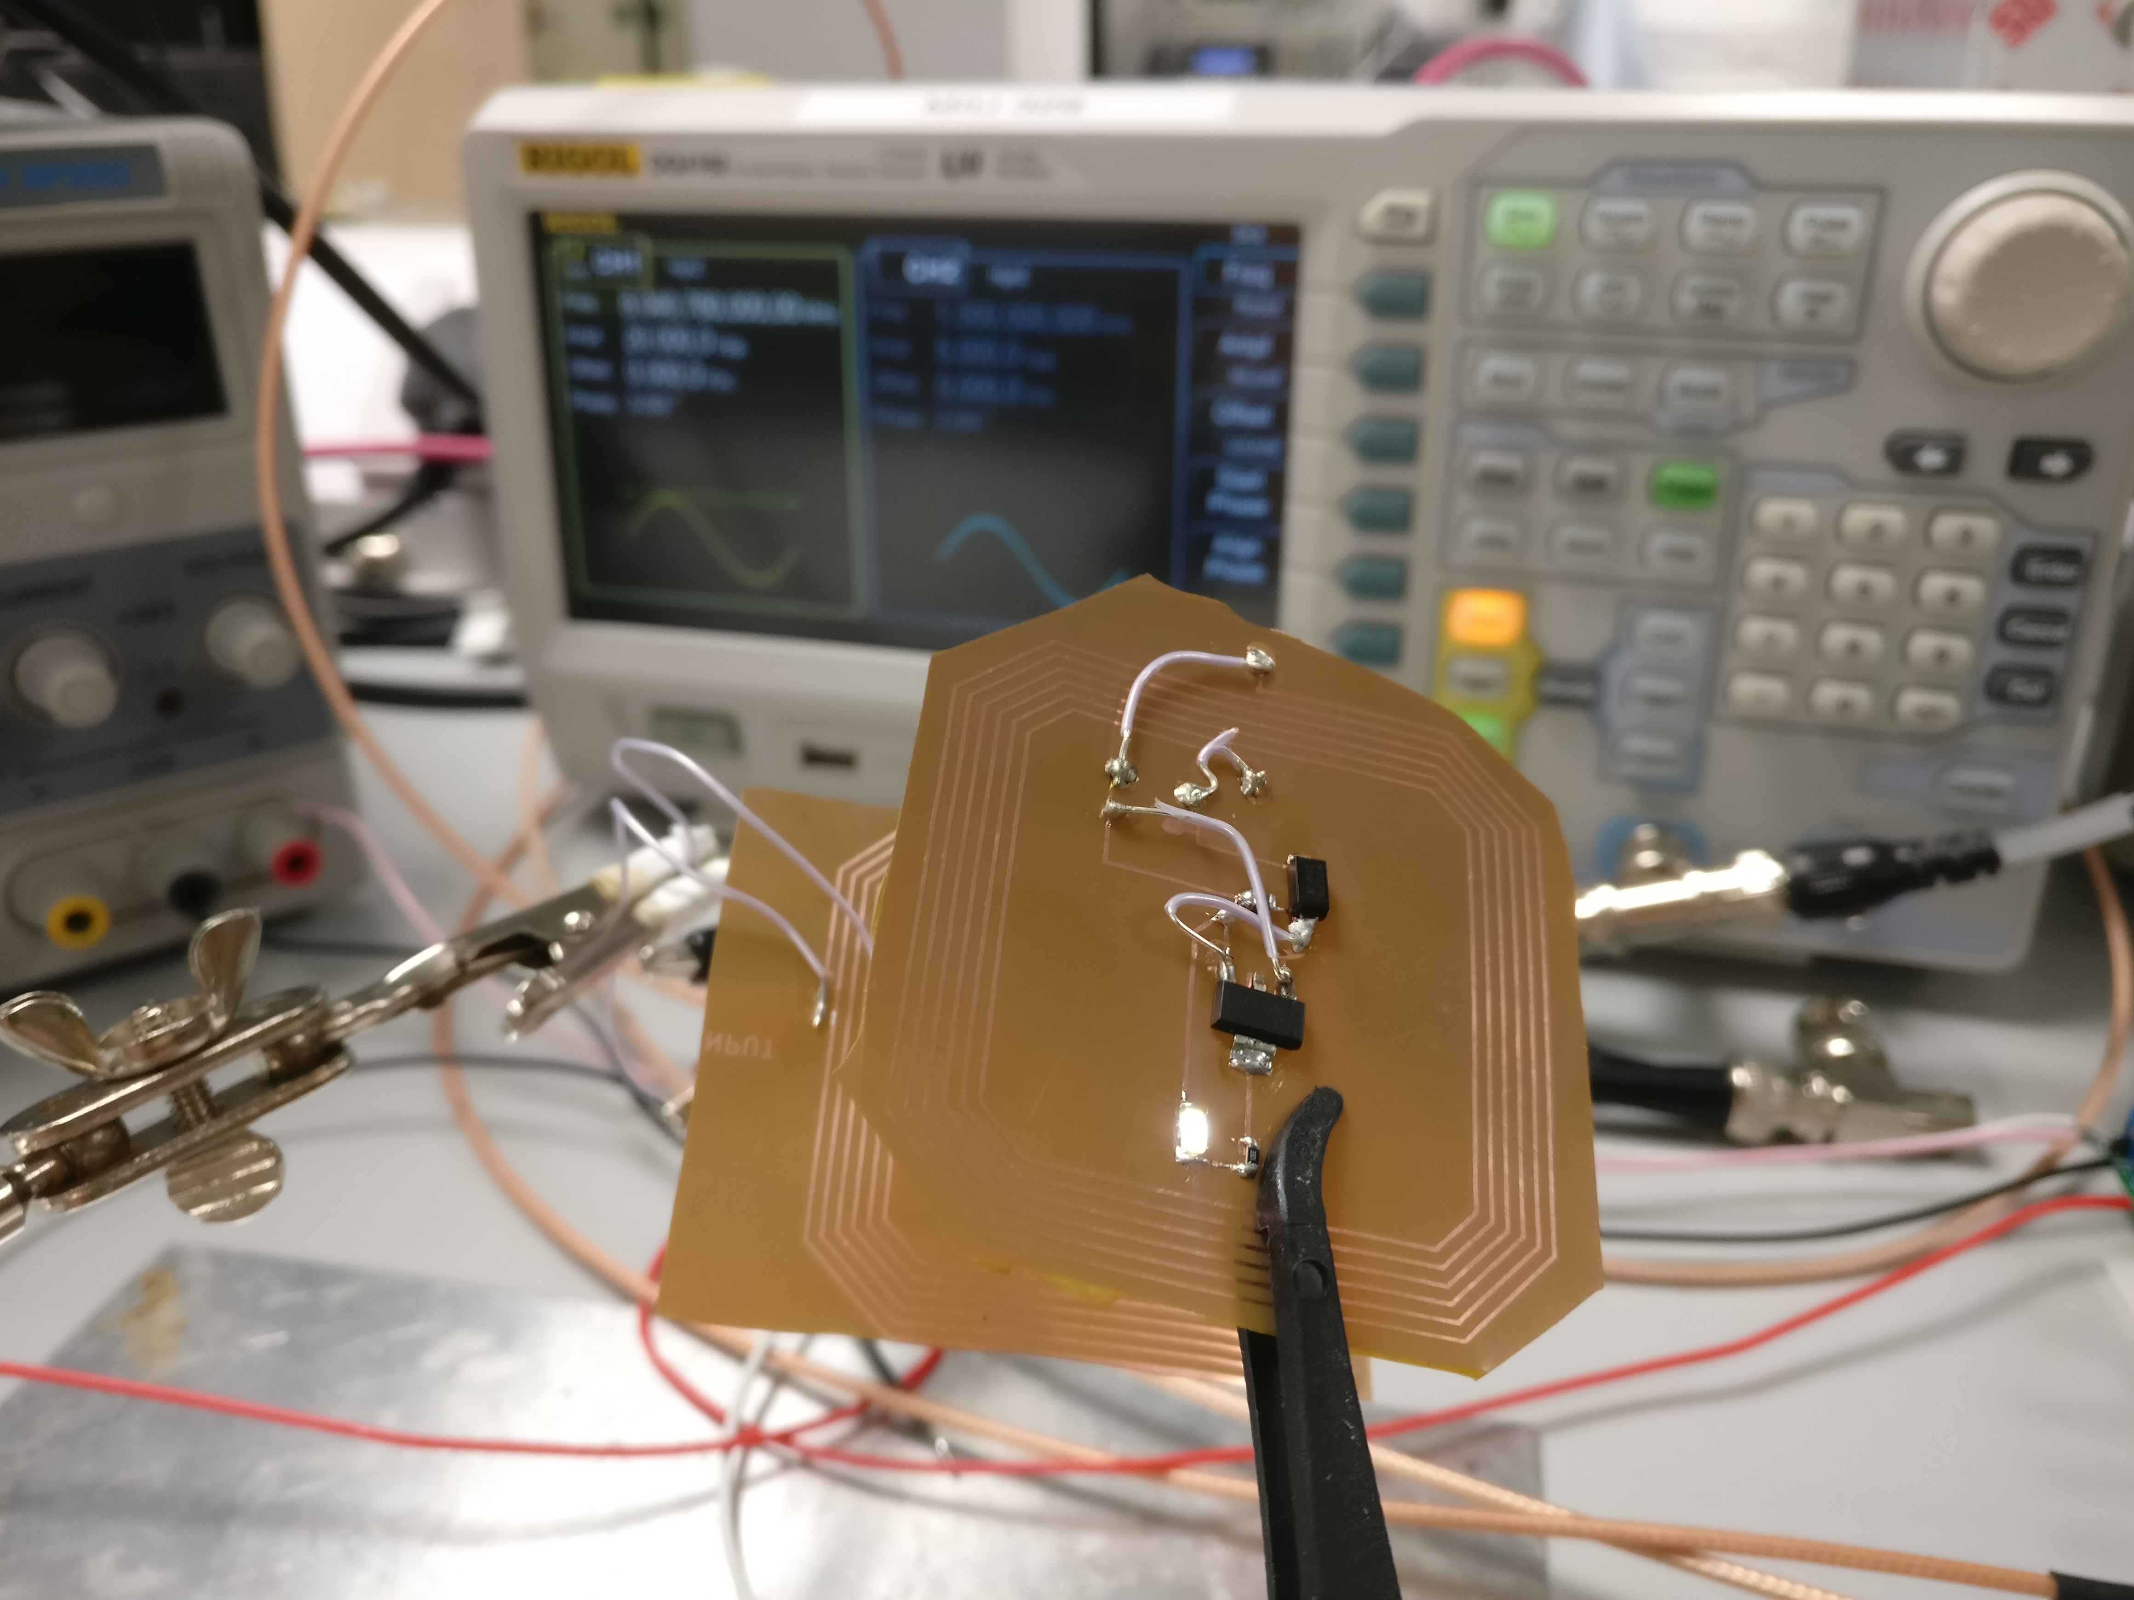
Bioimplantable Device
1. Current work
Not tunned antenna

Slide 6
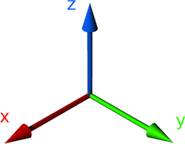
Bioimplantable Device
2. Results of the ongoing work
The antena firstly needs to be coupled with the primary coil. Then, we can move the antena to a certain reange and rotate it in XYZ axis.
The power on the led seems to remain stable thanks due to the LDO Voltage regulator. However, I need a way to measure the power while I am moving the antenna in different angles and distances to corroborate that the performance is correct despite the geometrical factor

